Slide 1

New Vietnamese restaurant in NYC
Trang Nguyen

Slide 2
Business problem
My mother has always wanted to own a small restaurant when she retires.
In NYC, the demand for Asian restaurants is increasing with the arrival of more Asians, and also because Asian cuisine has become more popular.
Finding an area to open a Vietnamese restaurant that has high access to customers and low competition is the problem.

Slide 3
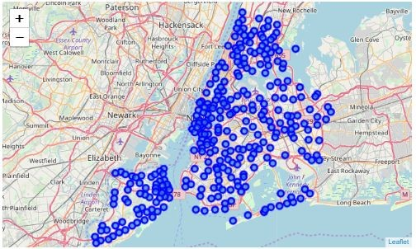
Data
Neighborhoods in New York City: 5 boroughs & 306 neighborhoods

Slide 4
Methodology
A dataframe with names of boroughs, neighborhoods, their corresponding latitudes & longitudes
Get the number of restaurants of the number of Vietnamese restaurants out of top 100 venues in each neighborhoods by utilizing Foursquare API
Visualize results by matplotlib and folium map

Slide 5
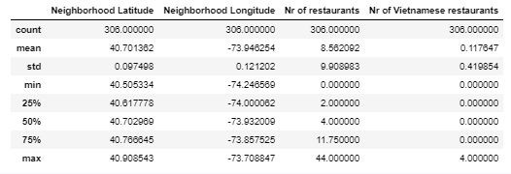
Results
Basic statistic for the number of restaurants out of top 100 venues in 306 neighborhoods in New York City

Slide 6
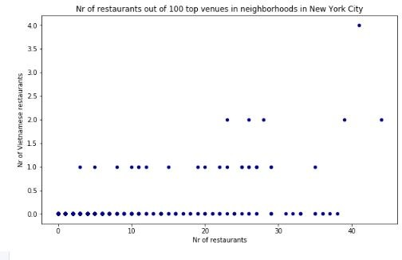
Results
Scatter plot of the number of restaurants out of top 100 venues in neighborhoods in New York City

Slide 7
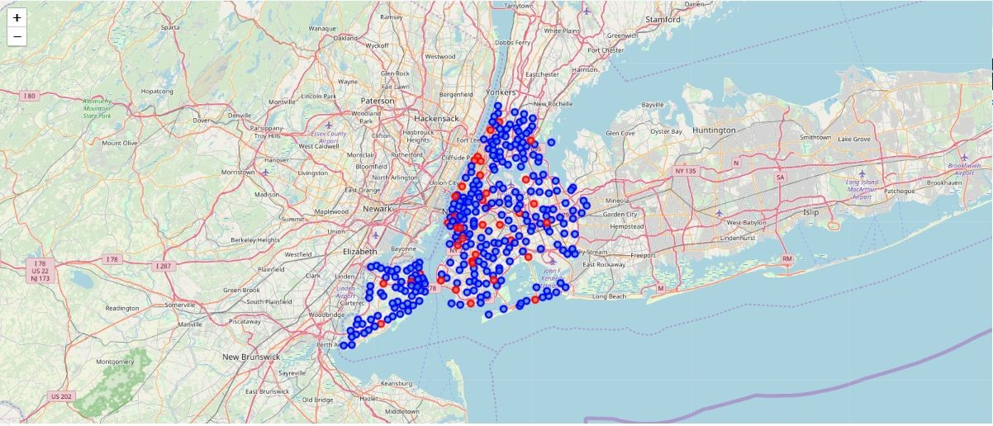
Results
The red markers highlight the recommended neighborhoods where the owner should open his new restaurant

Slide 8
Conclusion
There are 37 neighborhoods in NYC where there is no Vietnamese restaurant, the need of eating out is relatively high, and the competition on the market is relatively low.
Per research, I would recommend my mom to open the restaurant at Lincoln Square, since there are many other tourist attractions in the area, which will give us more access to customers.

